Slide 1
Spring Boot Series – Day 17
Topic: JWT Token Generation on Login — Secure API Access with Stateless Tokens
@CodeByHaindavi | #SpringWithMe

Slide 2
Why JWT on Login?
✔️ Traditional login just confirms the user is valid — but it doesn't give the client anything usable to access protected APIs. The backend knows the user is logged in, but the frontend is left empty-handed.
✔️ JWT flips that model by making authentication fully stateless — once verified, the server stops remembering the user. No sessions. No memory. Just a signed token the client carries.
✔️ Now, every successful login returns a JWT — a compact, secure string that proves identity. The frontend stores it (typically in localStorage), and includes it in every request. The server doesn't need to remember anything — it just verifies the token.
@CodeByHaindavi | #SpringWithMe

Slide 3
Login Flow with JWT
✔️ The user sends credentials through a structured login API — typically using a DTO with username and password.
✔️ Once authentication succeeds, the backend immediately generates a JWT — embedding claims like username, roles, issued time, and expiration.
✔️ Instead of returning just a success message, the backend responds with a structured JSON object — containing the token, user info, and roles.
✔️ The frontend receives the token and stores it securely — most commonly in localStorage or sessionStorage — to attach it on every protected request going forward.
@CodeByHaindavi | #SpringWithMe

Slide 4
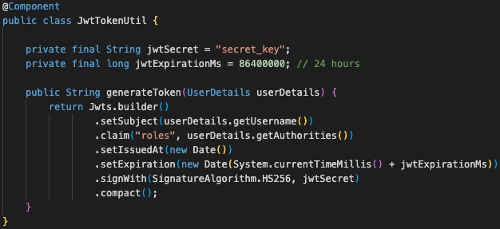
Inside JwtTokenUtil – Building the Token
✔️ The JwtTokenUtil class holds the core logic for token generation — especially the generateToken(String username) method that gets called after login.
✔️ It builds the token by embedding essential claims like username, assigned roles, issue timestamp, and expiry time — ensuring the token carries all required identity context.
✔️ The token is cryptographically signed using a secret key and an algorithm like HS256 — so even if someone sees the token, they can't modify it without breaking the signature.
✔️ An expiration time (e.g., 24 hours) is added to enforce token lifecycle — after that, the token becomes invalid and the user must re-authenticate.
@CodeByHaindavi | #SpringWithMe

Slide 5
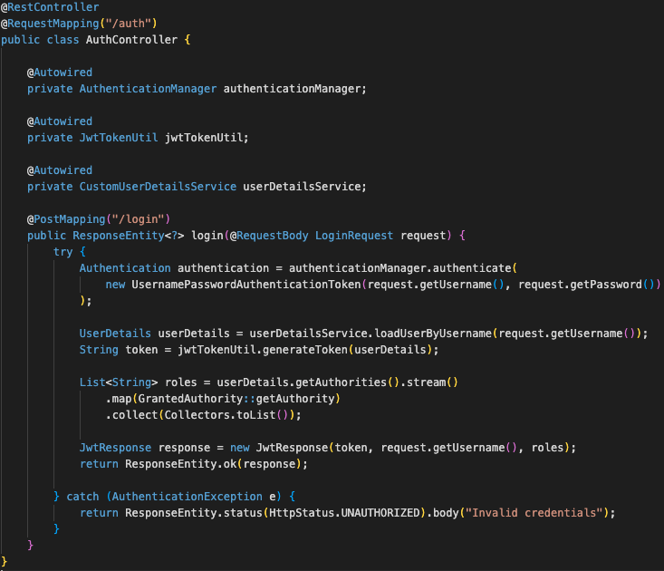
Returning the JWT in a Clean API Response
✔️ After successful authentication, the backend calls jwtTokenUtil.generateToken(username) to create a signed token tied to the user’s identity.
✔️ It collects the authenticated user’s details — username and roles — and wraps them with the token in a dedicated response DTO, often called JwtResponse.
✔️ The API now returns a structured JSON like: { "token": "eyJhbGciOiJIUzI1NiIsInR...", "username": "john_doe", "roles": ["CUSTOMER"] } — ready for the frontend to use in secured requests and route protection.
@CodeByHaindavi | #SpringWithMe

Slide 6
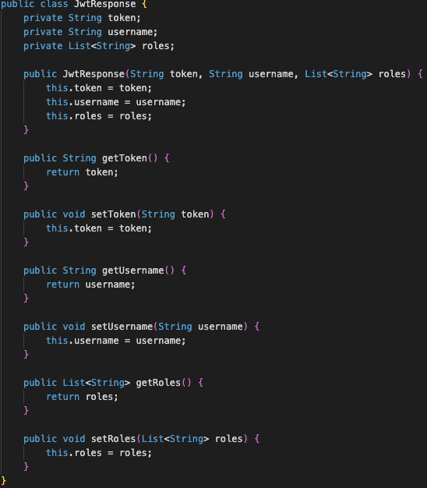
JwtResponse DTO – Packaging the Login Output
✔️ The JwtResponse DTO includes three key fields: token, username, and a list of roles — enough to represent the user’s identity and access scope.
✔️ This DTO replaces the typical success message — giving the frontend exactly what it needs to manage login state.
✔️ Once received, the frontend can store this response in memory or localStorage — and use it to initialize the session, display user info, and authorize routes.
@CodeByHaindavi | #SpringWithMe

Slide 7
JWT Structure – Breaking Down the Token
✔️ A JWT is made up of three parts: Header.Payload.Signature — each one Base64-encoded and separated by dots.
✔️ The Header defines the token type (JWT) and the signing algorithm used — usually something like HS256.
✔️ The Payload holds the claims — including sub (subject or username), roles, iat (issued at), and exp (expiration).
✔️ The Signature is created by signing the header and payload using a secret key — ensuring that no one can tamper with the token without detection.
@CodeByHaindavi | #SpringWithMe

Slide 8
📌 Hands-On Tip
✔️ Skipping user roles while generating the token leads to downstream failures — the system can't enforce role-based access without them.
✔️ Using a weak or hardcoded secret key makes the token easy to forge — anyone who cracks the key can impersonate real users.
✔️ Leaving out the expiration claim (exp) results in tokens that never expire — a major security risk in real-world applications.
✔️ Returning the token as a raw string instead of a structured JSON response causes integration issues — especially in frontend frameworks expecting key-value pairs.
@CodeByHaindavi | #SpringWithMe

Slide 9
💼 Interview Insight
How does JWT enable stateless authentication in REST APIs?
• JWT carries all the authentication data within the token itself — once issued, the server doesn’t need to store any session or user state.
• Every request includes the token in the header, and the server simply validates it using the secret key — no database lookups, no in-memory session tracking.
• This makes the system fully stateless — ideal for horizontal scaling, microservices, and containerized deployments.
What claims should be included inside a JWT?
• At minimum, include the sub (subject/username), iat (issued at), and exp (expiration) to handle identity and lifecycle.
• Include roles or authorities if your application uses role-based access control — so the token itself defines access boundaries.
• Optionally, add custom claims like userId, email, or tenantId if needed — but avoid sensitive data since JWTs are not encrypted.
@CodeByHaindavi | #SpringWithMe

Slide 10
📌 Recap – Day 17
📦 The login process no longer creates a session — it now issues a signed JWT that carries all necessary identity claims.
🧠 Every subsequent API request includes this token in the header — and the backend validates it without storing any user state.
🚀 This token-driven flow forms the foundation of true stateless security — scalable, efficient, and built for modern distributed systems.
👉 Coming up next: JWT Validation for Secured Endpoints — Verifying Every Request
@CodeByHaindavi | #SpringWithMe

